Slide 1
Welcome to AP Microeconomics
By: Carter Greene

Slide 2
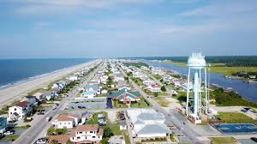
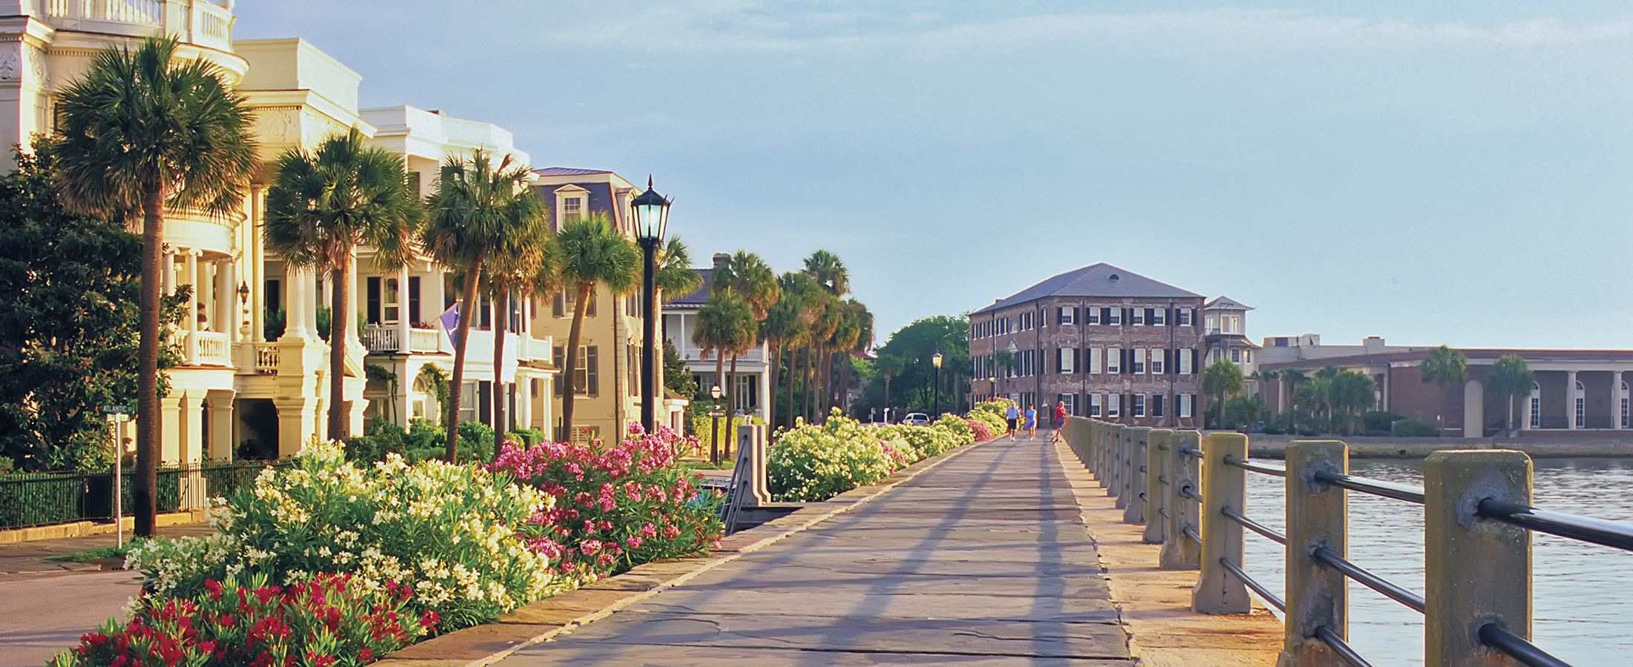
Kickoff:
Pick up both handouts from the front table.
Start filling out the getting to know you form.
We’ll discuss the syllabus later, so put it away for now.
Find your seat and be in it by the time the bell rings.
Roll call question: Favorite thing you did this summer?

Slide 3
Before we do anything:
Classroom Tour
Fire
Tornado
Lockdown

Slide 4
Laptop Policy:
You will find your chromebook under your desk at the beginning of each class. It should be left in the rack under your desk at the end of 3rd block
If your laptop is broken, missing keys, etc. let me know as soon as you notice.

Slide 5
Let’s get set-up:
Google Classroom:
Block 3A: kz0e46c
Block 3B: t0rjnz
Remind 101:
Block 3A text @heels57 to the number 81010
Block 3B text @heels82 to the number 81010
Also download the App

Slide 6
Syllabus Scavenger Hunt
Answers must be in complete sentences
Work with the person next to you or by yourself
Completed and submitted on Google Classroom.
Textbook pass out

Slide 7
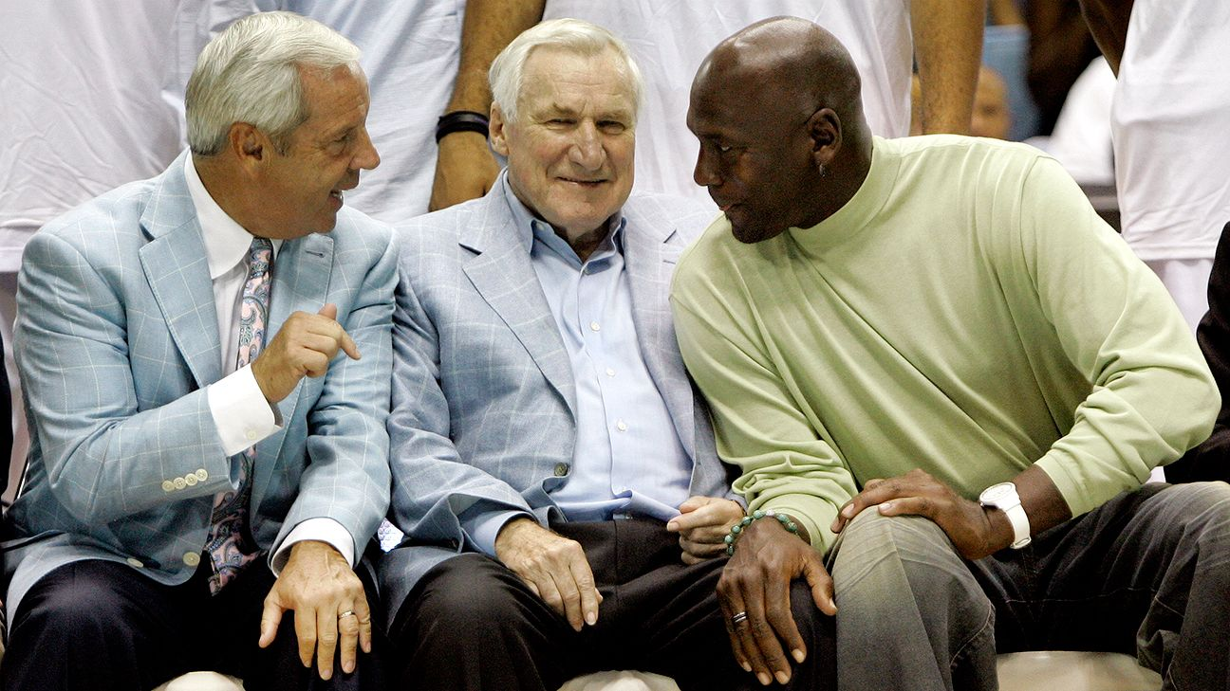
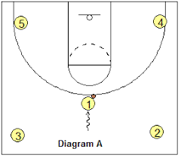
4 Corners

Slide 8
My favorite core subject in school is:
English
Math
Social Studies
Science

Slide 9
Where would the sorting hat put you?
Gryffindor
Ravenclaw
Slytherin
Hufflepuff
Middle- I don’t know what you’re talking about

Slide 10
My favorite type of music is:
Rock
Hip-Hop/Rap
Country
Pop (or EDM)

Slide 11
My favorite sport to watch is:
Basketball
Football
Baseball
Soccer

Slide 12
My favorite (of these) school is:
Dook
Wake
NC State
UNC-Chapel Hill

Slide 13
My favorite fast food is:
Wendys
McDonalds
Chick-fila
Bojangles

Slide 14
My favorite season is:
Winter
Spring
Summer
Fall

Slide 15
On Saturday night I would rather:
Go to a sporting event
Go to a concert
Go to a theater performance
Stay in and take it easy

Slide 16
I would rather learn by:
Listening to the teacher talk, taking notes, and asking Qs
Doing research on my own after the teacher gives me a subject/objective
Being given articles to read/videos to watch to teach a particular subject/objective
Something else

Slide 17
Which of the following best represents why you signed up for AP Micro?
To try and get college credit from passing the AP Exam.
I am genuinely interested in the study of economics.
The GPA bump from an AP class
Something else

Slide 18
Syllabus
Overview of class, basic procedures, expectations, grading, helpful hints, etc.
Short, informal quiz on this Thursday at the beginning of class.
If you have any questions at any point, DO NOT HESITATE TO ASK

Slide 19
Beginning of Class
NO LOITERING!!
Assigned seats regardless of configuration
Always read the board on your way in and pick up handouts
In your seat when the bell rings or you are late
Typically the kickoff is to be done independently, on Google Classroom and the expectation is that you are working on it quietly

Slide 20
General Rules
Stay in your seat while I’m talking.
No talking during or after tests or quizzes. I will give you a zero.
Bathroom policy
Food
May not use laptops for anything non-Economics/school related
Cell phone use

Slide 21
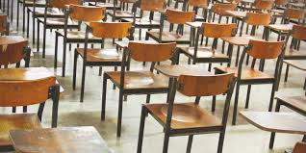
End of Class
Closure
I dismiss you
Laptop policy
Pick up your area
Make sure desks are neat and orderly

Slide 22
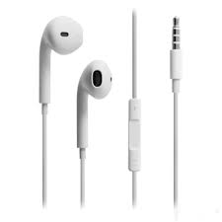
Materials to Bring Everyday
Pen/Pencil
Headphones that plug into chromebook
Colored pencils
Scissors
Binder for notes
Anything I ask you to bring via Remind

Slide 23
Absent Work
Absent work folder
Google Classroom
Ask a friend
Notes should be online or copy a friends
Complete within 3 days**
Formal assessments before/after school
Extended assignments still do the same day even if you’re absent

Slide 24
Late Work- maybe biggest pet peeve
20% automatically
May then be turned in anytime before the assignment’s respective unit test
Will likely be graded tougher
Will be graded much slower

Slide 25
Tutoring
Before school by appointment
6:55-7:15 drop in questions
Speak to me about other times
Knight Time

Slide 26
Dress Code
Follow it
Don’t make me be the one to call you out or send you to the office

Slide 27
Communication
Your parents are always more than welcome to email me with questions or comments
But be a self advocate
Try to respond quick
Be professional in communication
Night before tests/big assignments

Slide 28
Grading
Ten point grading scale → very generous
S1- 50% → 60% formal, 20% informal, 20% midterm
S2- 50% → 70% formal, 30% informal
DO NOT ASK ME TO BUMP/ROUND YOUR GRADE

Slide 29
AP EXAM
Wednesday, May 13th, 2020
Noon @ AK
Two Sections
MC and Free Response

Slide 30
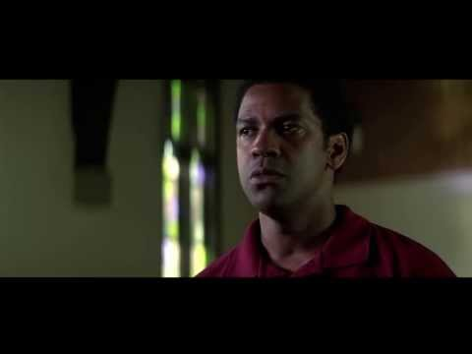
“Now I may be a mean cuss, but I’m the same mean cuss with everybody out there on that football field.” - Coach Boone

Slide 31
General Notes/Pieces of Advice
“Now I may be a mean cuss. But I'm the same mean cuss with everybody out there on that football field.”
You may not know the entire situation
STOP stressing about your grades so much. Put things in perspective.
Way I approach your final.
Be on time, be dialed in, be respectful, bring a positive attitude and energy
Political climate
Sports
Candy
Class can be as interesting as you’ll let it be
Classroom donations

Slide 32
Mr. Greene’s Pet Peeves
Late work
Talking during the Kickoff (unless directed to)
Coming to tutoring without specific questions
Loitering before the bell
In proper use of technology
Students who care too much about their grades
Students who do not participate
Group work does not mean divide and conquer

Slide 33
Student Pet Peeves:
What are some of your pet peeves involving things your teachers do?
Take a few minutes with the person beside you to compile a list
Be ready to share if called upon

Slide 34
CLOSURE
Google Classroom

Slide 35
End of Class
Pick up all trash
Scoot desks back to correct place
Remember: Syllabus quiz tomorrow!

Slide 36
My favorite type of movie is:
Rom-Com or Comedy
Sci-fi or SuperHero
Horror or Thriller
Drama or Adventure

Slide 37
My favorite elective subject in school is:
PE
Foreign Language
CTE
Arts

